Slide 1

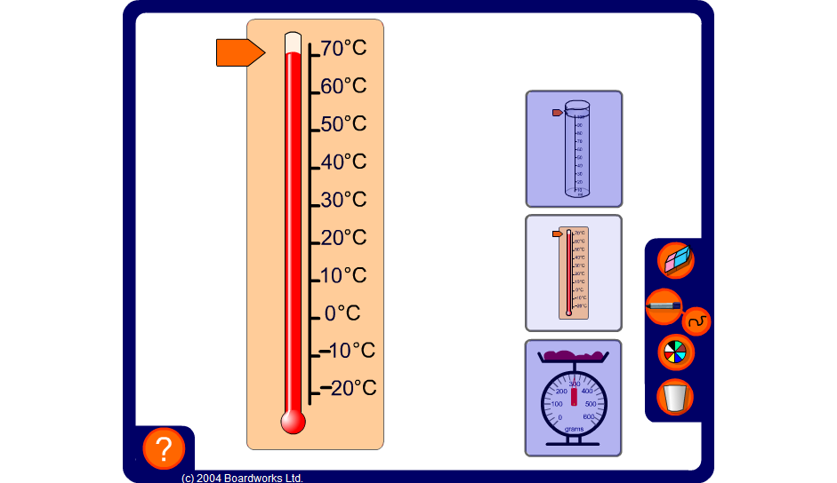


Rounding readings from scales
Notes:
Use the slider to show a variety of readings from each scale.
Use the measuring cylinder to round reading to the nearest 10ml, the scales to round numbers to the nearest 10g or 100g and the thermometer to round numbers to the nearest 10ºC including negative amounts.
Introduce the convention of rounding up half-way values.
Link:
S7 Reading scales

